Slide 1
COMP 1020
Spreadsheet Fundamentals With Excel

Slide 2
Who am I?
Dr. Barry Wittman
Not Dr. Barry Whitman
Education:
PhD and MS in Computer Science, Purdue University
BS in Computer Science, Morehouse College
Hobbies:
Reading, writing
Enjoying ethnic cuisine
DJing
Lockpicking
Stand-up comedy

Slide 3
How can you reach me?
E-mail: wittman1@otterbein.edu
Office: C123 (Art & Communication Building)
Phone: (614) 823-2944
Office hours: MWF 9:00 – 10:15 a.m.
MWF 1:45 – 2:45 p.m. (in C142)
W 4:00 – 5:00 p.m.,
TR 10:00 – 11:30 a.m.,
TR 2:00 – 4:00 p.m.,
and by appointment
Website:
http://faculty.otterbein.edu/wittman1/

Slide 4
Who are you?
Notes:
FAA Game

Slide 5
Why are we here?
State your name, and give the salutation you would prefer: Mr., Ms., or another
What's the purpose of this class?
What do you want to get out of it?
Do you want to be here?

Slide 6
Course Overview

Slide 7
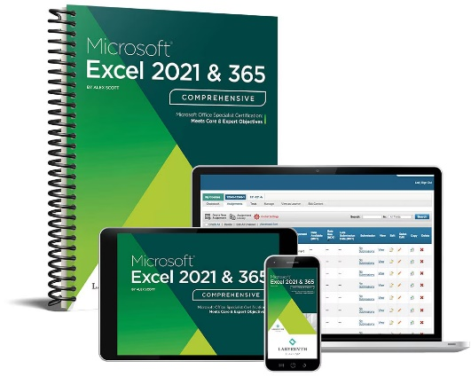
Textbook
Alex Scott
Microsoft® Excel 2021 & 365: Comprehensive
2022, Labyrinth Learning
ISBN-13: 978-1640614024 (Print)
ISBN-13: 978-1640614031 (Digital)

Slide 8
A note about the book…
You have to get the book
This whole class is exercises out of the book
Furthermore, you have to get a copy of the book that has an unused access code to Labyrinth eLab
The digital version of the book is much cheaper than the paper version

Slide 9
Course focus
Excel basics
Formulas
Functions
Charts
Filtering and views
Formatting
Date and time
What-If analysis
Conditions
Lookups
Tables
PivotTables

Slide 10
More information
For more information, visit the webpage: http://faculty.otterbein.edu/wittman1/comp1020
The webpage will contain:
The most current schedule
Notes available for download
Reminders about assignments, projects, and exams
Syllabus
Detailed policies and guidelines

Slide 11
Assignments

Slide 12
Twelve chapters
This course is divided into twelve chapters
For each chapter, there are:
Three assignments ("Reinforce your skills")
A self-assessment
A project
A test
All this work is done online, at your own pace, provided that it's done before the deadline for each chapter

Slide 13
Turning in work
Projects must be turned in by uploading them to Labyrinth eLab before the deadline
Late projects will not be accepted
Exception: Each student will have 3 grace days
You can use the grace days together or separately as extensions for all the work for a single chapter
You must inform me before the deadline that you are going to use grace days

Slide 14
Three units
The twelve chapters are arranged into three units
Each unit has an in-class test
These tests (and the final) are the only times you must be present in class
Chapters | Exam | Date
Chapters 1-4 | Exam 1 | 09/24/24
Chapters 5-8 | Exam 2 | 10/29/24
Chapters 9-12 | Exam 3 | 12/03/24
All | Final | 12/10/24 at 8-10 a.m.

Slide 15
Tentative schedule
Week | Class Meeting | Topics | Chapter | Notes
1 | 08/27/24 | Excel Basics | 1
2 | 09/03/24 | Formulas | 2 | Labor Day
3 | 09/10/24 | Functions | 3
4 | 09/17/24 | Charts | 4
5 | 09/24/24 | Exam 1
6 | 10/01/24 | Filtering and Views | 5
7 | 10/08/24 | Formatting | 6
8 |  | Date and Time | 7 | October Break
9 | 10/22/24 | What-If Analysis | 8
10 | 10/29/24 | Exam 2
11 | 11/05/24 | Conditions | 9
12 | 11/12/24 | Lookups | 10
13 | 11/19/24 | Tables | 11
14 | 11/26/24 | PivotTables | 12 | Thanksgiving
15 | 12/03/24 | Exam 3

Slide 16
Policies

Slide 17
Grading breakdown
24%
Assignments
24%
Projects
5%
Self-assessments
12%
Chapter tests
15%
Final exam
20%
Unit tests

Slide 18
Grading scale
A | 93-100 | B- | 80-82 | D+ | 67-69
A- | 90-92 | C+ | 77-79 | D | 60-66
B+ | 87-89 | C | 73-76 | F | 60-62
B | 83-86 | C- | 70-72

Slide 19
Attendance
You must attend for the three unit tests and the final
On all other days, you are free to come to class or work from home
Unit tests must be made up before the scheduled time, for excused absences

Slide 20
Academic dishonesty
Don't cheat
First offense:
I will try to give you a zero for the assignment, then lower your final letter grade for the course by one full grade
Second offense:
I will try to fail you for the course and kick you out of Otterbein University
Refer to the Student Handbook for the official policy
Ask me if you have questions or concerns
You are never allowed to look at another student's Excel
Don't use AI tools like ChatGPT for any work that you turn in

Slide 21
Disability Services
The University has a continuing commitment to providing access and reasonable accommodations for students with disabilities, including mental health diagnoses and chronic or temporary medical conditions. Students who may need accommodations or would like referrals to explore a potential diagnosis are urged to contact Disability Services (DS) as soon as possible. DS will facilitate accommodations and assist the instructor in minimizing barriers to provide an accessible educational experience. Please contact DS at DisabilityServices@otterbein.edu. More info can also be found here. Your instructor is happy to discuss accommodations privately with you as well.

Slide 22
Upcoming

Slide 23
Reminders
Read Chapters 1 and 2
There's no need to read the Overview Chapter unless you really want to
Sign up with the course code (available on Brightspace) for Labyrinth eLabs
For Chapters 1 and 2, do:
Reinforce your skills: E1-R1, E1-R2, E1-R3, E2-R1, E2-R2, E2-R3
Self-assessments
Project: E1-P1 and E2-P1
Chapter 1 Test and Chapter 2 Test
All due by 11:59 p.m. on 9/06/2024

